Slide 1
ESCAPE Centralization Effort
WDO Instructors
431 SCMS
Feb 2026
Version 1

Slide 2
431st SCMS Instructor POCs
Robins
SP – Christopher Tucker
ES – Terry Finley
Tinker
SP – Jose Rios
ES – Christopher Gomez
Hill
SP – Stacy Labarko
ES – Christopher (Casey) Greene

Slide 3
Classification
The classification of this workshop is unclassified.

Slide 4
Purpose
Due to the 7 Apr 2025 directive from the Office of the Deputy Secretary of Defense to optimize the workforce, the 448th Supply Chain Management Wing is centralizing the execution of several ESCAPE system actions. Full Operational Capability is 1 Apr. This workshop covers what this centralization effort is, the updated roles/responsibilities, and how to use the workflow tool.
ESCAPE – Enterprise Supply Chain Analysis Planning and Execution
Notes:
This new process will free up the valuable time of planners and specialists, allowing them to focus on higher-value, strategic activities such as engaging with vendors, improving supply chain supportability, and resolving complex readiness issues that directly impact the warfighter.
SPM access will change to READ-ONLY on 1 May. Users will get a notification prior to this going into effect.

Slide 5
Overview
Cell Structure
Cell SharePoint
Roles/Responsibilities of IPT vs Centralized Cell
User Guide
Live Demo
Scenarios (SP & DP)
IPT – Integrated Product Team, SPM – Service Parts Management, SP – Supply Planning, DP – Demand Planning

Slide 6
Structure
Tinker
NH-301-03 Section Chief Tinker
NH-1670-03 SME x3
NH-1670-02 SME x1
NH-301-03 Section Chief - Robins
NH-2010-03 SME x4
NH-2010-02 SME x2
NH-1670-03 SME x3
NH-1670-02 SME x1
NH-04 Flight Chief
NH-2010-03 SME x4
NH-2010-02 SME x2
NH-1670-03 SME x3
NH-1670-02 SME x1
NH-301-03 Section Chief - Hill
NH-1670-03 Demand Planning Lead
NH-2010-03 Supply Planning Lead
NH-2010-03 SME x4
NH-2010-02 SME x2
NH-301-03 x6
Hill
Robins
TBD
Notes:
42 Total Civilians: 6 Supervisor/Leads, 30 ES and SP SMEs, 6 301s
The location for the Flight Chief and the Supply Planning Lead and Demand Planning Leads are TBD

Slide 7
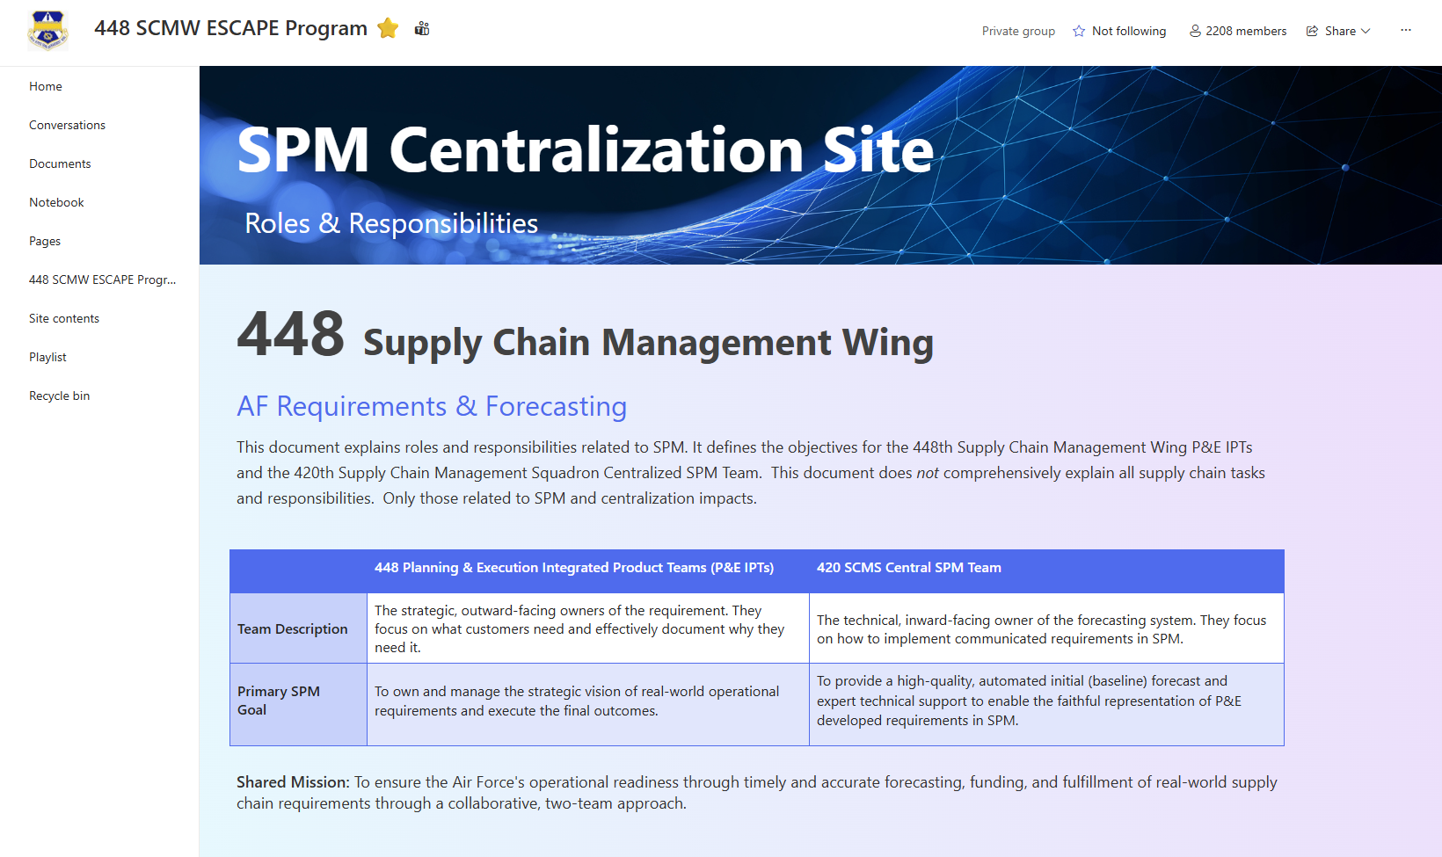
SPM Centralization SharePoint
https://usaf.dps.mil/teams/448thESCAPEProgram/SitePages/Strategic-Overview.aspx

Slide 8
Roles & Responsibilities
420th SCMS/GUNB Centralized Cell
Technical Support
Collaborative Alignment
Notes:
2. Technical Support: Serve as the primary execution and support hub for P&E IPTs, proactively resolving SPM issues and managing system data integrity.
3. Collaborative Alignment: Act on workflow triggers from IPTs to perform the necessary technical adjustments in SPM, aligning the system's forecast with the communicated real-world need.
Centralized Cell handles the “how” of the system execution.

Slide 9
Roles & Responsibilities
Examples of Demand Planning Tasks
Causal Failure Rate Overrides
Demand Adjustments by Exception
Failure Rate Overrides
Forecasting Method Change
RTS Adjustment
Review Reasons
Examples of Supply Planning Tasks
Manual Additives
Serv/Unserv Adjustments
Terminations
Lead Times
MRRD Input
Order Adjustments
Actual Unit Price/DOLP
DMISA Project Orders
Review Reasons
Notes:
Review Reasons will be handled by the Centralized Cell

Slide 10
Roles & Responsibilities
P&E Integrated Product Teams
Customer Engagement
Strategic Analysis
Directing Action
Validate
Execute Requirements
Notes:
1. Customer Engagement: Serve as the primary interface with the Chain of Command, Program Office, MAJCOMs, Depots, and other stakeholders to strategically determine supply chain needs.
2. Strategic Analysis: Understand the operational intent behind demand signals and identify deviations where the ESCAPE initial (baseline) requirement forecast does not reflect real-world need, via IPT requirement reviews.
3. Directing Action: Initiate forecast alignments via workflow triggers to ensure the accuracy of short, medium, and long-term requirements.
4. Validate: Concur on final requirements and funding for execution.
5. Execute requirements via all standard Air Force methods from initiation to receipt.
IPT has full control of the “what” and “why” for their items.

Slide 11
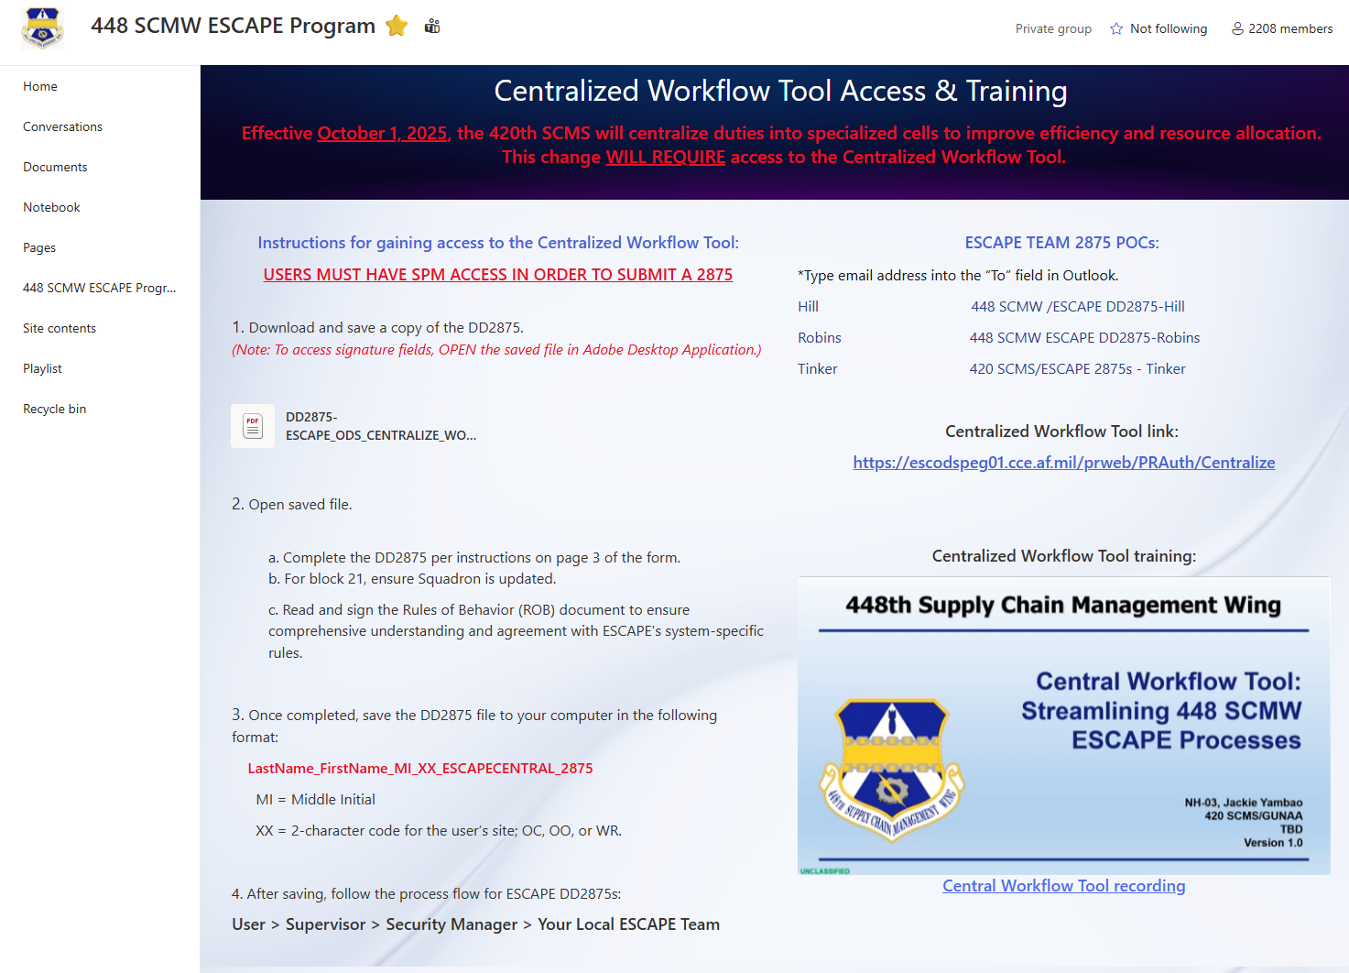
2875 Access
https://usaf.dps.mil/teams/448thESCAPEProgram/SitePages/Centralization.aspx
Notes:
This SharePoint has all the steps and instructions to fill our your 2875 to gain access to the workflow tool

Slide 12
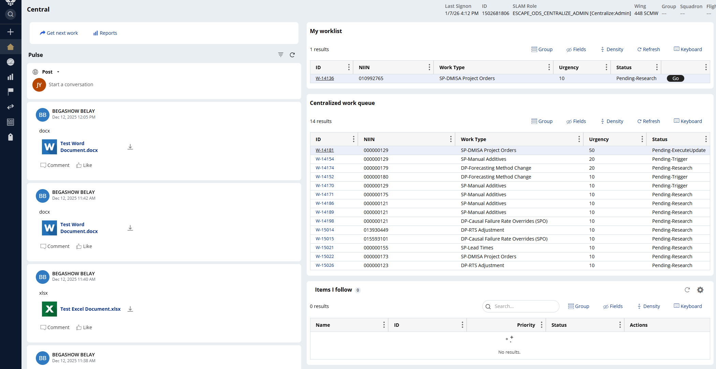
Workflow Tool
https://escodspeg01.cce.af.mil/prweb/PRAuth/Centralize
Notes:
Home Screen for the Workflow Tool

Slide 13
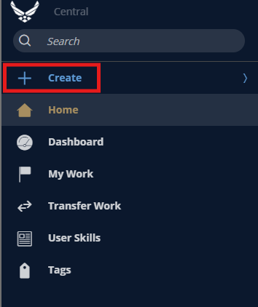
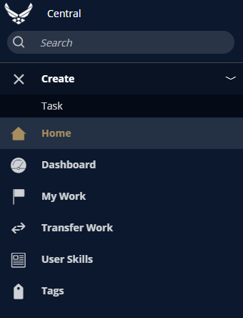
Creating a Central Task Request
Step 1: Open a New Task
Notes:
After logging in, click the + Create Task icon located in the upper left corner of the page to open a new request form.

Slide 14
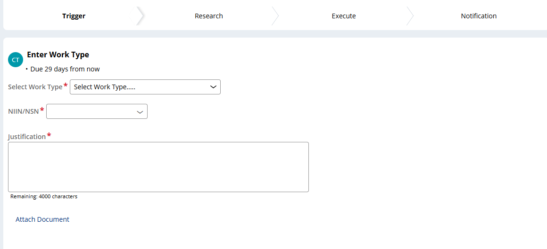
Creating a Central Task Request
Step 2: Fill out the Task Details
Notes:
Work Type
Select the specific ESCAPE action being requested from this dropdown menu. This is the first and most important selection to make, as it determines what, if any, additional fields will be required to submit the task.
NIIN(s)
Enter the 9-digit NIIN this request applies to and ensure this is accurate. A user can typically submit multiple NIINs in one trigger if the same action is required for them all but input just one NIIN in the actual NIIN field.
Justification/Notes
This is the most critical field in a request. Use this space to provide complete and thorough justification for the task. Explain the "why" behind the request with as much detail as possible. Narrative quality directly impacts how quickly and accurately the central cell can research and execute the task.

Slide 15
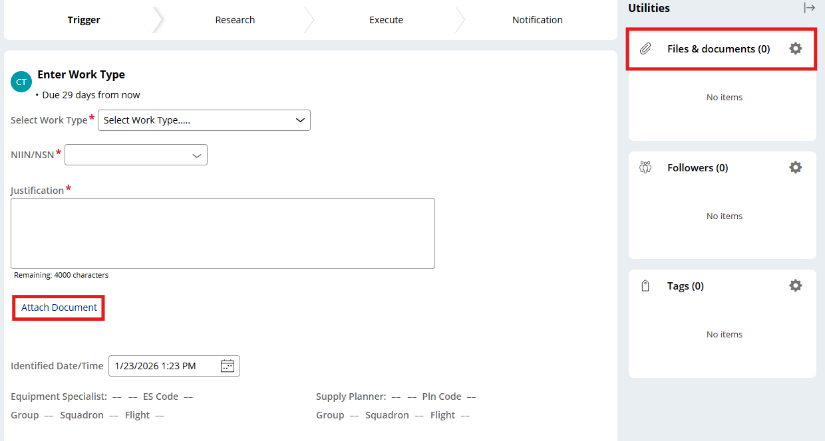
Creating a Central Task Request
Step 3: Attach All Supporting Documentation
Notes:
Before submitting, all relevant supporting documentation must be attached. Use the Attach Document link or upper-right hand container to upload the necessary files (e.g., spreadsheets, forms, screenshots, emails). Providing complete documentation gives the central cell the full context to act on a request.

Slide 16
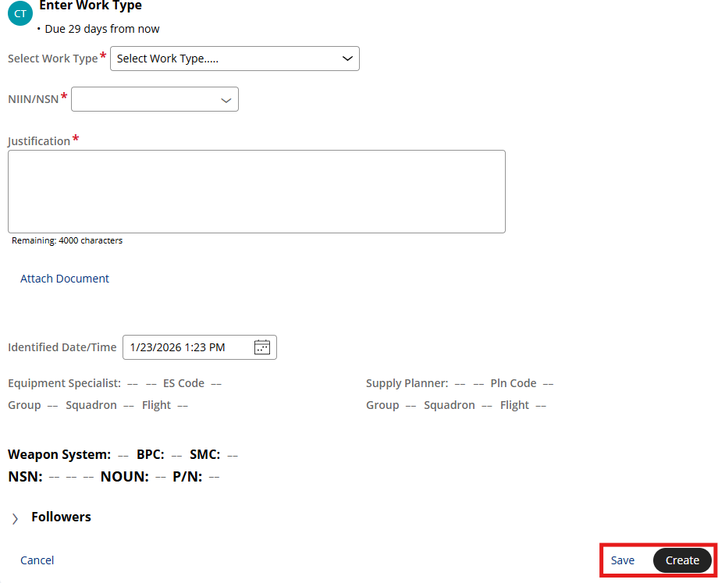
Creating a Central Task Request
Step 4: Submit the Task and Record the Task ID
Notes:
After reviewing all fields and attaching the necessary documents, click the Create button. The task request can also be saved using the Save option if more time is needed to provide the information needed. Once created, the request will be processed and automatically assigned a unique Task ID (e.g., W-12345). This ID will appear on the Centralized Work Queue for the cell team . The user should reference this Task ID for all future communication about the request.
TBD where it will appear for requestor roles

Slide 17
Four Stages of Central Task Management
Trigger
Research
Execute
Notification
Notes:
Trigger: The process begins when an IPT Supply Planner or Equipment Specialist logs into the Central Workflow Tool to create (+) a "trigger" task request. The request must be thoroughly documented, providing clear justification and all necessary attachments. Triggers like Review Reasons will automatically generate in the Workflow Tool.
Research: The central SP or ES receives the trigger from the Centralized Work Queue and begins the research phase. This often involves collaboration between the central SMEs and the requesting user to validate the request.
Execute: Based on the results of the research, the central SME will Approve, Reject, or Return the task. - If Approved, the SME takes the required action within ESCAPE. - If Rejected, the SME provides the requesting user with a rationale for why the request was deemed inappropriate. - If Returned, the SME provides relevant information or questions back to the requester via a Pulse notification. The “Return” option is only available for specific task types.
Notification: This is the final stage. The requesting user is notified in the tool of the outcome (e.g., that the task was completed and closed out).
Process from start to finish should not take more than 5-7 business days.

Slide 18
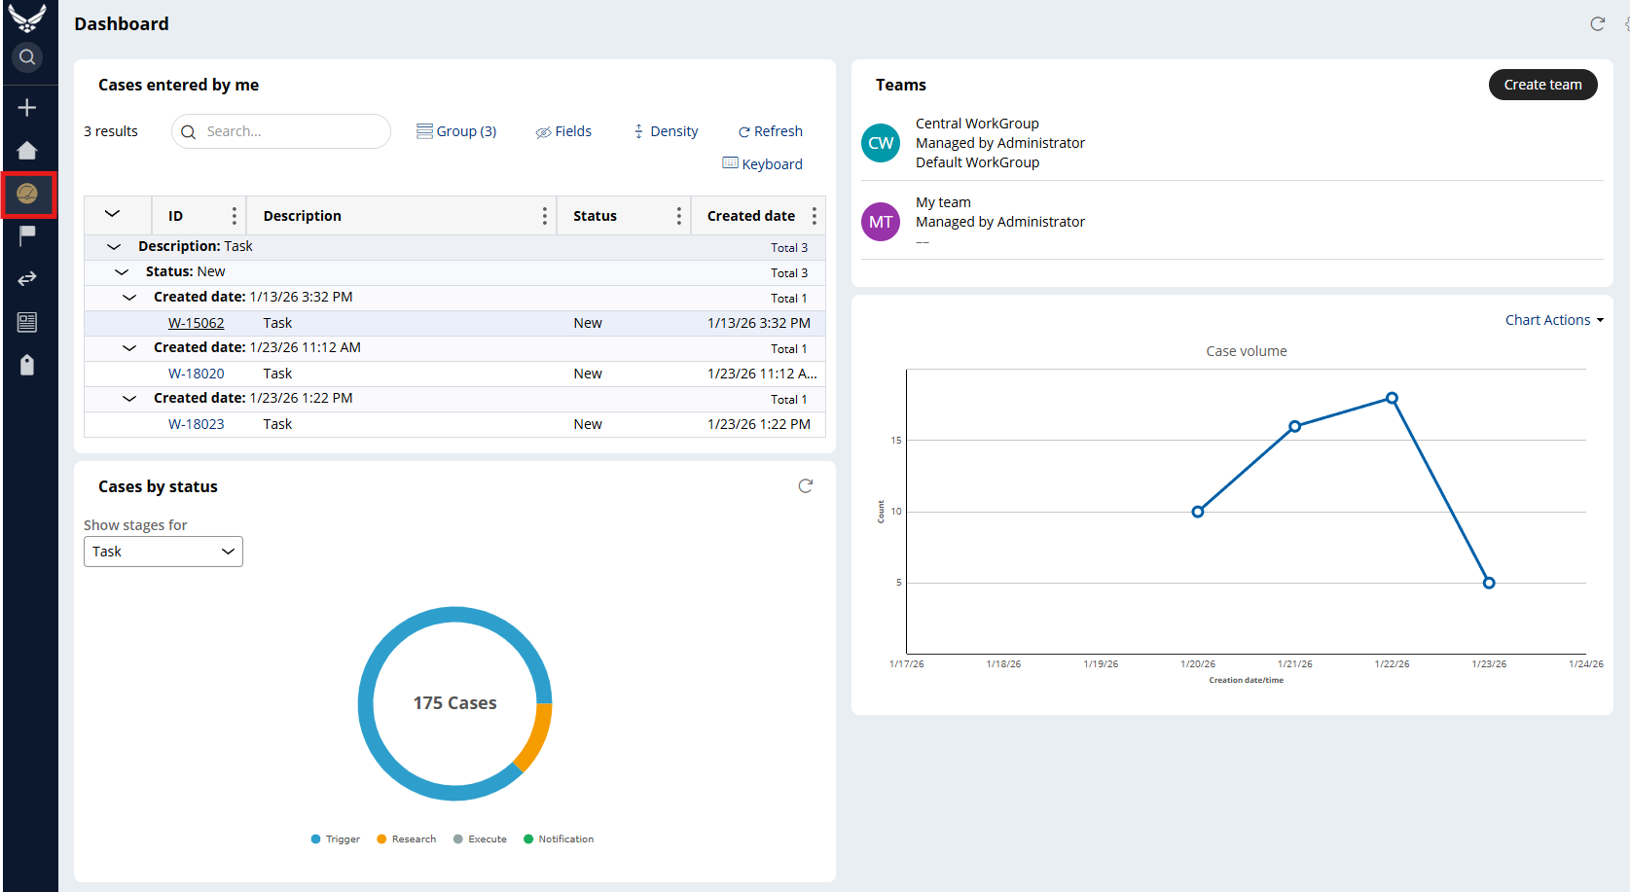
Dashboard
Central Hub for managing all submitted tasks
Notes:
The Dashboard is the central hub for managing all submitted tasks. It allows users to see the status of their requests at a glance and access them for communication.
Dashboard
For submitted tasks, the Dashboard displays a list of tasks created by the user and their current status.
Click the Dashboard icon on the left-hand menu bar to open the view.
From this list, a user can open a specific task to view its details and communicate with the assigned cell member via the Pulse feed. This is the primary method for tracking submitted work.
My Worklist
Tasks that are saved without being submitted are stored in the user’s personal My Worklist container. It can be opened from this list to be edited and submitted when ready.

Slide 19
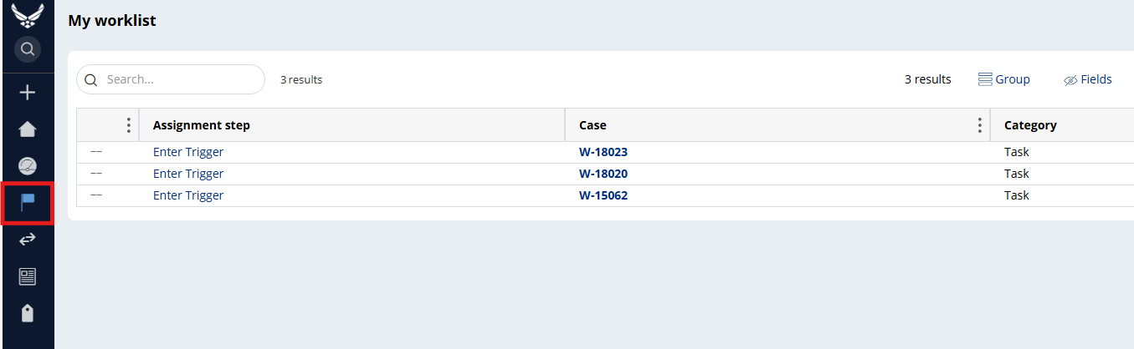
My Worklist
Managing un-submitted drafts
Notes:
Navigate to the My Worklist container to find all saved, un-submitted tasks.
A task can be opened from this list to continue editing, adding attachments, and officially submitting it.

Slide 20
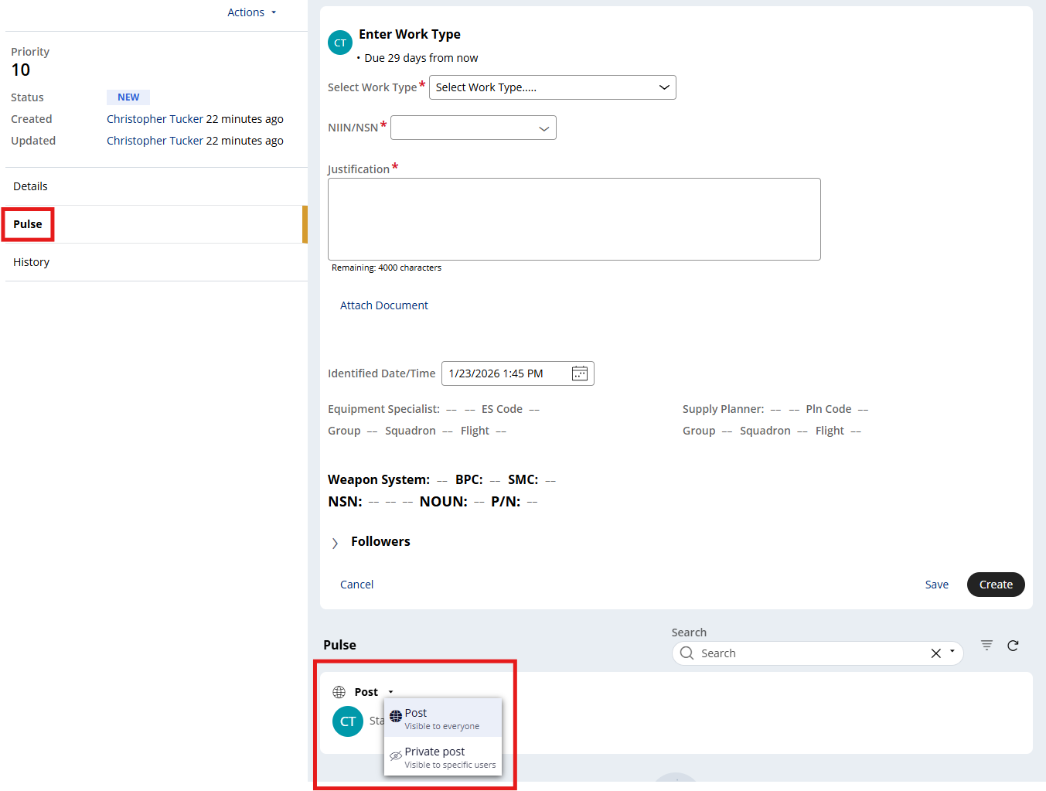
Pulse
Used for all communication about a submitted task
Notes:
Open the task from the Dashboard by clicking on a Task ID hyperlink. The pulse feed and posting option is also accessible directly from the upper left-hand container of the home page.
From the home page or inside the task, use the Pulse feed to post updates or respond to questions from the central cell.
Choose post visibility:
Private Post: This is the required option for nearly all communication. Private posts are visible only to the requester and assigned cell members.
Whether responding to a @mention or creating a new Pulse, a user must choose the post’s visibility. This choice is critical for security and clarity.
Private Post: This is the required option for nearly all communication. A private post is only visible to the requestor and the specific cell member(s) assigned to the task. Always use this when discussing case-specific details.
Public Post: A public post is visible to ALL users of the Central Workflow Tool. Only use this for general questions or comments that are relevant to the entire user community and contain no sensitive information. Avoid using this for task-specific communication.

Slide 21
References
User Guide
SharePoint: https://usaf.dps.mil/teams/448thESCAPEProgram/SitePages/Strategic-Overview.aspx
2875: https://usaf.dps.mil/teams/448thESCAPEProgram/SitePages/Centralization.aspx

Slide 22
Scenarios
Supply Planning (SP)
Demand Planning (DP)

Slide 23
Supply Planning Scenario #1
SP identifies new/urgent requirement that is not captured in SPM’s regular forecastable demand due to a NASA special project
NIIN needs a manual additive to be imported for the Order Plan to generate the correct Buy/Repair recommend to meet this special need
IPT completes the Additive Checklist spreadsheet pulled from the 420th SCMS ESCAPE Program SharePoint to attach to the Task Request
SP completes Additive-Open spreadsheet to attach to the Task Request
SP also attaches email correspondence with NASA
Why requirement cannot be captured as regular demand or as a rate/percentage
Calculation Methodology
Burndown Plan
Approval
Justification: “Please refer to attached supporting documentation for a manual additive of 15 ea to be added to support NASA’s special project to be started next year. This is a one-time requirement.”

Slide 24
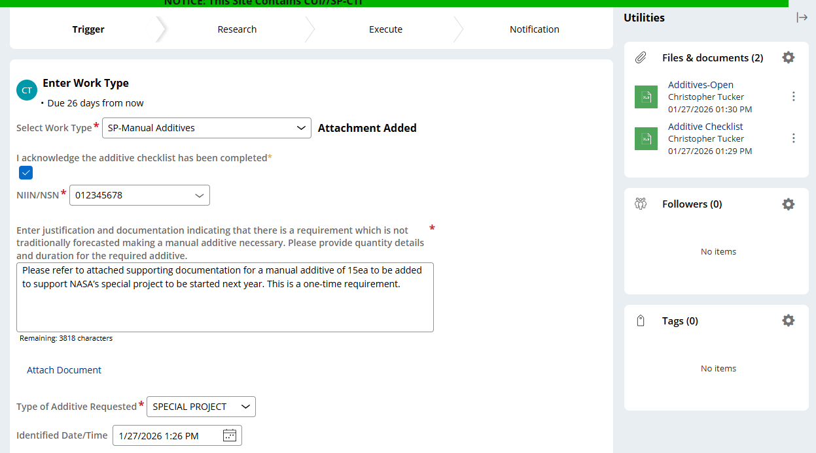
Supply Planning Scenario #1

Slide 25
Supply Planning Scenario #2
SP identifies an open repair order from the contractor reporting in SPM that has been completed and returned
The open repair order needs to be closed in SPM
SP completes a transaction history showing receipt of asset on EZ document number to attach to the Task Request
Justification: “See attached transaction history showing receipt of 1ea asset on EZXXXXXXXXXXXX document number. The Host Order ID CRPR:FDXXXXXXXXXXXX.EZXXXXXXXXXXX in the Orders container needs to be closed out.”

Slide 26
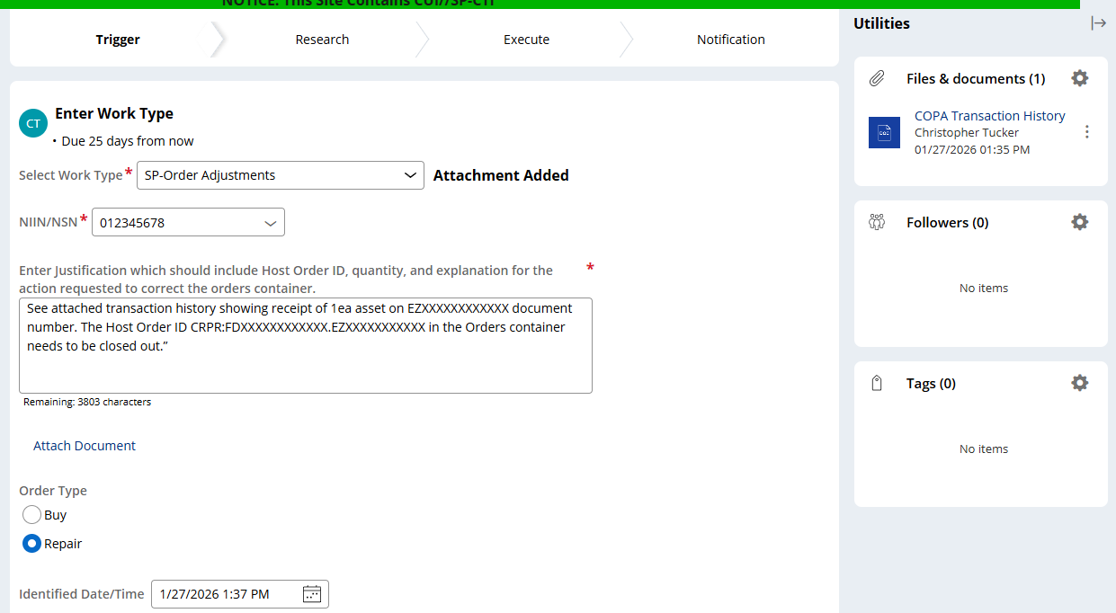
Supply Planning Scenario #2

Slide 27
Demand Planning Scenario #1
ES receives an email from the shop supervisor stating the condemnation of an obsolete configuration flight control
NIIN needs a MISTR Condemnation usage of 1 marked in the corresponding month in SPM
ES creates a trigger tasking of “DP – Demand Adjustments by Exception” to inform the Cell team to remove the usage
ES attaches the email documentation to support creation of the trigger
Who is condemning the part? Boom Back Shop
What AF managed part is it? NIIN: XX-XXX-XXXX P/N: X-XXXX-XXX
When this happened? 30 Nov 2023
Why is it needed? Obsolete part, no requirement needed
Justification: “Please refer to the attached supporting documentation for removal of 1ea MISTR CND for Nov 2023 due to condemnation of an AAC Y, obsolete, KC-135 Fore Flap, NSN: XXXX-XX-XXX-XXXX P/N: X-XXXXX-XXX. No requirement needed.”

Slide 28
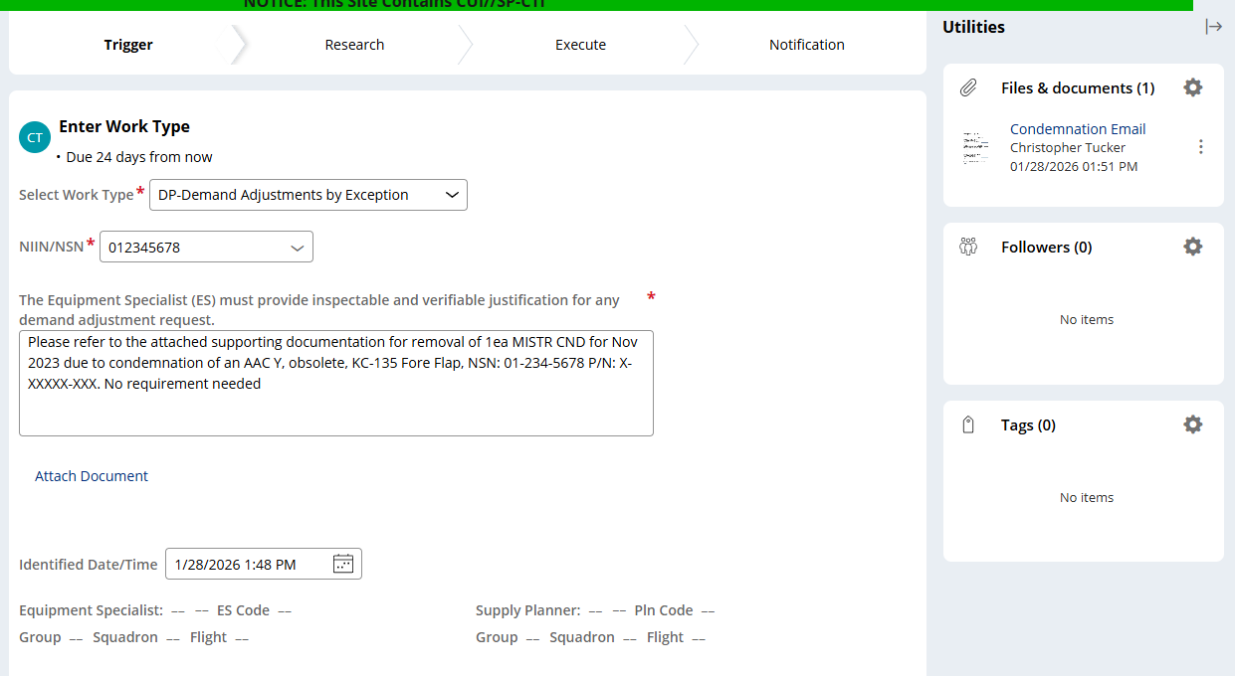
Demand Planning Scenario #1
Notes:
Example of completed info input to create a task. Then attach email as supporting documentation

Slide 29
Demand Planning Scenario #2
ES receives SPO Task Requirement Letter stating a future forecast effort for the replacement of damaged or repaired strut nacelle fairings
NIIN needs a replacement rate override of 20% inputted in SPM
ES creates a trigger tasking of “DP – Causal Failure Rate Overrides (SPO)” to inform the Cell team to update the replacement rate override
ES attaches Task Letter to support creation of the trigger
Who is the requirement source? KC-135 AFLCMC/WLTNB Program Office
What AF managed part it is? KC-135 Fairing, Aircraft – NIIN: XX-XXX-XXXX, P/N: XXXXXXXX-XXX
When is this expected to begin? FY2027 or 1 Oct 2026
Why is it needed? Extinguished repair efforts for strut nacelle fairings
Justification: “PDM task letter 1B10 is a one-time through the fleet task that will last 5 years. Based on PDM work schedule of 69 aircraft/year, QPA of 4, and a 20% replacement factor would be 56/year with a total 5-year requirement of 276 ea. A replacement rate override of 20% needs to be inputted in SPM”

Slide 30
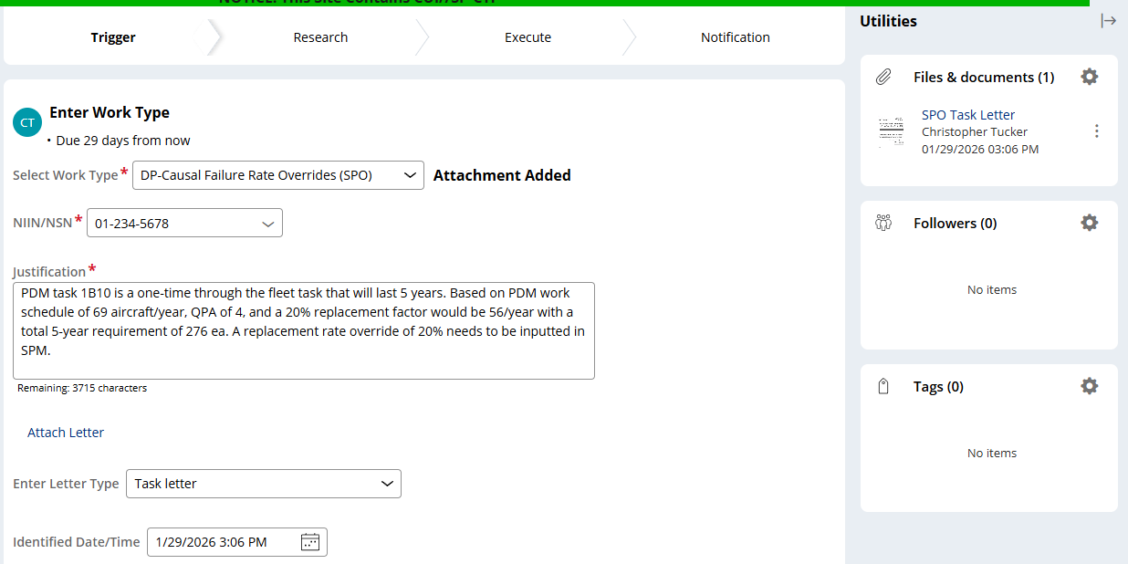
Demand Planning Scenario #2

Slide 31
Review Questions
Which of the following is a primary responsibility of the Centralized Cell?
Customer Engagement c) Collaborative Alignment
Executing Requirements d) Strategic Analysis
True or False: After the 1 May date, IPTs will still have full edit access to the ESCAPE system.
The _________ feature in the workflow tool is used for all communication about a submitted task.
Creating a central task request involves all of the following steps EXCEPT:
Open a New Task c) Fill out Task Details
Attach all supporting documentation d) Receive approval via Pulse
True or False: After the Go-Live date, users will no longer need to work in SPM at all.
Notes:
c) Collaborative Alignment
False. IPT access will change to READ-ONLY
Pulse
d) Receive approval via Pulse
False

Slide 32
FAQ
What is the FOC date for the Cell?
1 Apr
Is there one cell or multiple at Hill, Tinker, Robins?
420 SCMS/GUNB houses new central cell co-located across all three locations
When will my SPM access change to READ-ONLY?
1 May
Do I still have to work in SPM?
Yes, for example, the REAL Tool and AIRs for controlled inventory
How important is my use of the workflow tool?
Very important because it informs the Cell of changes needed to be made that impact accuracy of forecast, buy/repair requirements, and overall weapon system support

Slide 33


